Slide 1
C++
Md. Abdur Rahman
Senior Computer Scientist
Centre for Advanced in Research in Sciences (CARS)
University of Dhaka

Slide 2
C++ Input/Output
C/C++ IO are based on streams, which are sequence of bytes flowing in and out of the programs
In input operations, data bytes flow from an input source (such as keyboard, file, network or another program) into the program.
In output operations, data bytes flow from the program to an output sink (such as console, file, network or another program).

Slide 3
C++ Input/Output
Streams acts as an intermediaries between the programs and the actual IO devices, in such the way that frees the programmers from handling the actual devices, so as to archive device independent IO operations.

Slide 4
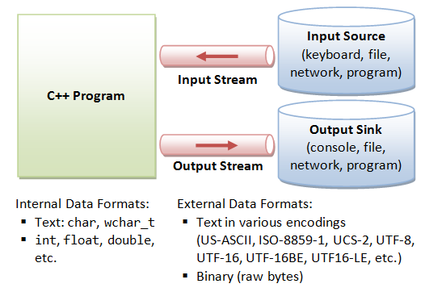
C++ Input/Output

Slide 5
C++ Input/Output
Data which is received by the program without any modifications and sent to the output device without any modifications is known as unformatted data.
On the other hand, sometimes we may want to apply some modifications to the actual data that is being received or sent.
For example, we might want to display an integer in hexadecimal format in the output, leave some whitespace when printing a number and adjustments in the decimal point. Such modified data in known as formatted data.

Slide 6
Formatted Data Example
If we want to display a decimal number in hexadecimal format, we can use the hex manipulator as shown below:
cout<<hex<<15
Above line displays 15 in hexadecimal format as F.
Example: formattedio.cpp

Slide 7
Input/output with files
C++ provides the following classes to perform output and input of characters to/from files:
ofstream: Stream class to write on files
ifstream: Stream class to read from files
fstream: Stream class to both read and write from/to files
These classes are derived directly or indirectly from the classes istream and ostream.
cin is an object of class istream and cout is an object of class ostream

Slide 8
Input/output with files
We can use our file streams the same way we are already used to use cin and cout, with the only difference that we have to associate these streams with physical files.
Example: file1.cpp
The example creates a file called example.txt and inserts a sentence into it in the same way we are used to do with cout, but using the file stream myfile instead.

Slide 9
Open a file
In order to open a file with a stream object we use its member function open:
open (filename, mode);
Where filename is a string representing the name of the file to be opened, and mode is an optional parameter with a combination of the following flags:

Slide 10
Open a file
ios::in | Open for input operations.
ios::out | Open for output operations.
ios::binary | Open in binary mode.
ios::ate | Set the initial position at the end of the file. If this flag is not set, the initial position is the beginning of the file.
ios::app | All output operations are performed at the end of the file, appending the content to the current content of the file.
ios::trunc | If the file is opened for output operations and it already existed, its previous content is deleted and replaced by the new one.

Slide 11
Writing operations on text files
Open file with append mode
Example: file2.cpp

Slide 12
Reading from a file
Exmple: file3.cpp
Closing a file
When we are finished with our input and output operations on a file we shall close it so that the operating system is notified and its resources become available again. For that, we call the stream's member function close. This member function takes flushes the associated buffers and closes the file: myfile.close();

